Slide 1
Computer Communication Networks (CMP 206)
Compiled by
Egena Onu, Ph.D.

Slide 2
Data Link Layer
Data link is the second layer of the OSI model;
This layer carries out complicated and complex functionalities to aid data communication.
The data link layer abstracts underlying hardware and presents itself as the medium to communicate with.
It functions between two devices that are directly connected in some form:
Point-to-point
Broadcast
Notes:
The Data link layer is the second layer of the OSI Model that carries out complex functionalities to aid data communication
It is responsible for converting data stream to signals, bit by bit and to send the signal over the underlying hardware/media.

Slide 3
Data Link Layer
Data link layer is responsible for converting data stream to signals, bit by bit and to send the signal over the underlying hardware/media.
The receiver picks data which are in the form of electrical signal from the hardware and assemble them in a recognisable frame format then handovers to upper layer.
Data link layer has two sub layers:
Logical link control: handles protocols, flow-control and error control.
Media access control: handles actual control of the media.

Slide 4
Functionalities of Data Link
Data link layer performs many tasks for the upper layers.
Some of these tasks include:
Framing
Addressing
Synchronisation
Error control
Flow control
Multi access
Notes:
Framing: takes packets from network layer and encapsulates them into frames. The frame consists of Header, Data and Trailer.
Addressing: provides layer II hardware addressing mechanism
Synchronization: before data is sent both devices have to be synchronized
Error control: handles errors and provides error reporting mechanisms to the sender
Flow control: handles flow control and makes sure devices work with the same speed and capacity

Slide 5
Functionalities of Data Link
Framing
Data-link layer takes packets from Network Layer and encapsulates them into Frames.
Then, it sends each frame bit-by-bit on the hardware.
At the receiving end, data link layer picks up signals from hardware and assembles them back into frames.
These frames are known as Ethernet frames.

Slide 6
Functionalities of Data Link
Framing
A frame consists of a header, data and the trailer.
The header carries the source and destination MAC addresses and the type of the frame in transit.
The data in the frame is the layer III data packet.
The trailer is necessary for error detection and correction.
Notes:
As part of the IEEE 802.3 Ethernet standard, data is encapsulated with instructions in the form of a header and a trailer before it can be propagated over physical media on which Ethernet is supported. Each stage of encapsulation is referred to by a protocol data unit or PDU, which at the data link layer is known as a frame.
Ethernet frames contain instructions that govern how and whether data can be transmitted over the medium between two or more points. Ethernet frames come in two general formats, the selection of which is highly dependant on the protocols that have been defined prior to the framing encapsulation.

Slide 7
Functionalities of Data Link
Addressing
Data-link layer provides layer-2 hardware addressing mechanism.
Hardware address is assumed to be unique on the link.
It is encoded into hardware at the time of manufacturing.
This address is referred to as MAC address.

Slide 8
Functionalities of Data Link
Addressing
A MAC address is a unique physical address assigned to each network adapter in a computer, or mobile device.
It is a 48 bit value, consisting of twelve hexadecimal characters.
The most common format for displaying a MAC address is using six groupings of two characters separated by a hyphen or colon:
D4-BE-DP-8D-46-9A

Slide 9
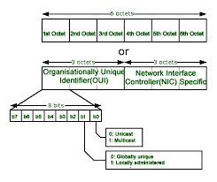
Functionalities of Data Link
Addressing

Slide 10
Functionalities of Data Link
Synchronisation
When data frames are sent on the link, both machines must be synchronized in order to transfer to take place.
Error control
Sometimes signals may have encountered problem in transition and the bits are flipped.
These errors are detected and attempted to recover actual data bits.
It also provides error reporting mechanism to the sender.

Slide 11
Functionalities of Data Link
Flow Control
Devices on same link may have different speed or capacity.
Data-link layer ensures flow control that enables both machine to exchange data on same speed.
Multi Access
When host on the shared link tries to transfer the data, it has a high probability of collision.
Data-link layer provides mechanism such as CSMA/CD to equip capability of accessing a shared media among multiple Systems.

Slide 12
Error Correction and Detection
The upper layers work on a generalized view of network architecture therefore are not aware of the actual hardware data processing.
Hence, the upper layers expect error-free transmission between the systems.
Most of the applications would not function expectedly if they receive erroneous data.
Applications such as voice and video may not be that affected and with some errors they may still function well.
Data-link layer uses some error control mechanism to ensure that frames (data bit streams) are transmitted with certain level of accuracy.
Notes:
But to understand how errors is controlled, it is essential to know what types of errors may occur.

Slide 13
Types of Error
There are three types of error that occurs during transmission:
Single bit error
Multiple bit error
Burst error

Slide 14
Error Detection
Errors in the received frames are detected using anyone of two methods:
Parity Check and
Cyclic Redundancy Check (CRC).
In both cases, few extra bits are sent along with actual data to confirm that bits received at other end are same as they were sent.
If the counter-check at receiver end fails, the bits are considered corrupted.

Slide 15
Error Detection
Parity Check
One extra bit is sent along with the original bits to make number of 1s either even in case of even parity, or odd in case of odd parity.
The sender while creating a frame counts the number of 1s in it.
For example, if even parity is used and number of 1s is even then one bit with value 0 is added. This way number of 1s remains even.
If the number of 1s is odd, to make it even a bit with value 1 is added.

Slide 16
Error Detection
Parity Check
The receiver counts the number of 1s in a frame.
If the count of 1s is even and even parity is used, the frame is considered to uncorrupted and is accepted.
If the count of 1s is odd and odd parity is used, the frame is still not corrupted.
If a single bit flips in transit, the receiver can detect it by counting the number of 1s.
But when more than one bits are erroneous, then it is very hard for the receiver to detect the error.

Slide 17
Error Detection
Cyclic Redundancy Check (CRC)
CRC is a different approach to detect errors in the received frame.
This technique involves binary division of the data bits being sent.
The divisor is generated using polynomials.
The sender performs a division operation on the bits being sent and calculates the remainder.
Before sending the actual bits, the sender adds the remainder at the end of the actual bits.
Actual data bits plus the remainder is called a codeword.
The sender transmits data bits as codewords.

Slide 18
Error Correction
In the digital format, an error in data can be corrected using two methods:
Backward error correction
Forward error correction

Slide 19
Error Correction
Backward Error Correction
When the receiver detects an error in the data received, it requests back the sender to retransmit the data unit.
Backward Error Correction is simple and can only be efficiently used where retransmitting is not expensive.
For example, fiber optics cable and other guided media.
But in case of wireless transmission retransmitting may cost too much.

Slide 20
Error Correction
Forward Error Correction
When the receiver detects some error in the data received, it executes error-correcting code, which helps it to auto-recover and to correct some kinds of errors.
To correct the error in data frame, the receiver must know exactly which bit in the frame is corrupted.
To locate the bit in error, redundant bits are used as parity bits for error detection.
For example, we take ASCII words (7 bits data), then there could be 8 kind of information we need: first seven bits to tell us which bit is in error and one more bit to tell that there is no error.

Slide 21
Data Link Control and Protocols
The data-link layer is responsible for implementation of point-to-point flow and error control mechanism.
Flow Control
When a data frame (Layer-2 data) is sent from one host to another over a single medium, it is required that the sender and receiver should work at the same speed.
That is, sender sends at a speed on which the receiver can process and accept the data.
If sender is sending too fast the receiver may be overloaded, (swamped) and data may be lost.
Two types of mechanisms can be deployed to control the flow:
Stop and Wait
Sliding Window
Notes:
What if the speed (hardware/software) of the sender or receiver differs? If sender is sending too fast the receiver may be overloaded, (swamped) and data may be lost.
Flow Control is a technique that generally observes proper flow of data from sender to receiver. It is very essential because it is possible for a sender to transmit data or information at very fast rate and hence receiver can’t receive this information and process it. This can happen only if receiver has very high load of traffic as compared to sender, or if receiver has power of processing less as compared to sender.
Flow control is basically, a technique that gives permission to two stations that are working and processing at different speeds to just communicate with one another. Flow control in Data Link Layer simply restricts and coordinates the number of frames or amount of data the sender can send just before it waits for an acknowledgment from the receiver. This means that flow control is a set of procedures that explains to the sender how much data or frames it can transfer or transmit before data overwhelms the receiver.
The receiving device also contains only limited amount of speed and memory to store data. This is why receiving device should be able to tell or inform the sender about stopping the transmission or transferring of data on temporary basis before it reaches limit. It also needs buffer, large block of memory for just storing data or frames until they are processed.

Slide 22
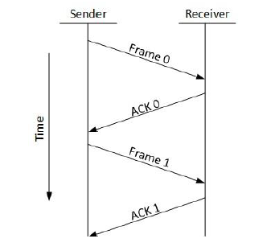
Flow Control
Stop-and-Wait
This flow control mechanism forces the sender after transmitting a data frame to stop and wait until the acknowledgement of the data-frame sent is received.

Slide 23
Flow Control
Stop-and-Wait
Advantages
The stop and wait method of error control is very easy and simple and each of the frames is checked and acknowledged well.
It can also be used for noisy channels.
This method is also very accurate.
Disadvantages
This method is fairly slow.
In using this method, only one frame can be sent at a time.
It is very inefficient and makes the transmission process very slow.

Slide 24
Flow Control
Sliding Window
In this flow control mechanism, both sender and receiver agree on the number of data-frames after which the acknowledgement should be sent.
Unlike the stop and wait flow control mechanism that wastes resources, this protocol tries to make use of underlying resources as much as possible.

Slide 25
Error Control
When data-frame is transmitted, there is a probability that data-frame may be lost in the transit or it is received corrupted.
In some cases, the receiver does not receive the correct data-frame and sender does not know anything about any loss.
In such case, both sender and receiver are equipped with some protocols which helps them to detect transit errors such as loss of data-frame.
Hence, either the sender retransmits the data-frame or the receiver may request to resend the previous data-frame.

Slide 26
Error Control
There are defined requirements for error control mechanism:
Error detection
The sender and receiver, either both or any, must ascertain that there is some error in the transit.
Positive ACK
When the receiver receives a correct frame, it should acknowledge it.

Slide 27
Error Control
Negative ACK
When the receiver receives a damaged frame or a duplicate frame, it sends a NACK back to the sender and the sender must retransmit the correct frame.
Retransmission
The sender maintains a clock and sets a timeout period.
If an acknowledgement of a data-frame previously transmitted does not arrive before the timeout, the sender retransmits the frame, thinking that the frame or its acknowledgement is lost in transit.

Slide 28
Error Control
There are three types of techniques used by data link layer to control the errors by Automatic Repeat Requests (ARQ):
Stop and Wait ARQ
Go-Back-N ARQ
Selective Repeat ARQ

Slide 29
Error Control
Stop and Wait ARQ
In stop and wait ARQ the following transitions occur:
The sender maintains a timeout counter.
When a frame is sent, the sender starts the timeout counter.
If acknowledgement of frame comes in time, the sender transmits the next frame in queue.
If acknowledgement does not come in time, the sender assumes that either the frame or its acknowledgement is lost in transit. Sender retransmits the frame and starts the timeout counter.
If a negative acknowledgement is received, the sender retransmits the frame.

Slide 30
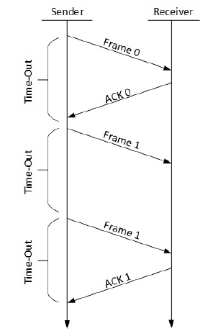
Error Control
Stop and Wait ARQ
Notes:
Stop and wait ARQ mechanism does not utilize the resources at their best. When the acknowledgement is received, the sender sits idle and does nothing.

Slide 31
Error Correction
Go-Back-N ARQ
In Go-Back-N ARQ method, both sender and receiver maintain a window.
The sending-window size enables the sender to send multiple frames without receiving the acknowledgement of the previous ones.
The receiving-window enables the receiver to receive multiple frames and acknowledge them.
The receiver keeps track of incoming frame’s sequence number.

Slide 32
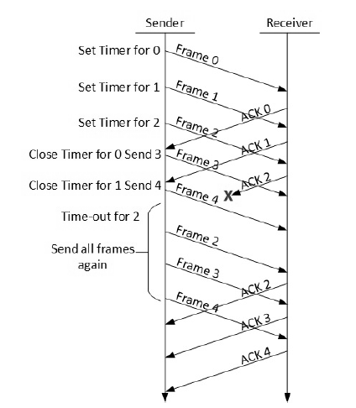
Error Correction
Go-Back-N ARQ

Slide 33
Error Control
Go-Back-N ARQ
When the sender sends all the frames through the window, it checks up to what sequence number it has received positive acknowledgement.
If all frames are positively acknowledged, then the sender sends next set of frames.
If the sender finds that it has received NACK or has not receive any ACK for a particular frame, it retransmits all the frames after which it does not receive any positive ACK.
Notes:
In Go-back-N ARQ, it is assumed that the receiver does not have any buffer space for its window size and has to process each frame as it comes. This enforces the sender to retransmit all the frames which are not acknowledged.

Slide 34
Error Correction
Selective Repeat ARQ
In Selective-Repeat ARQ, the receiver while keeping track of sequence numbers, buffers the frames in memory and sends NACK for only frame which is missing or damaged.
The sender in this case, sends only packet for which NACK is received.

Slide 35
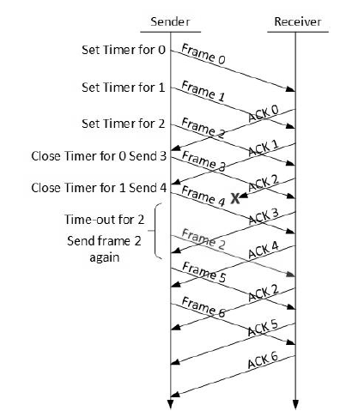
Error Correction
Selective Repeat ARQ

Slide 36
Data Link Layer Protocols
There are two important protocols in link layer. These are:
Address Resolution Protocol (ARP)
Point to Point Protocol (PPP)

Slide 37
Link Layer Protocols
ARP
Data link layer forwarding relies on the knowledge of the MAC address of the destination.
Before transmission can occur, the source must be aware of the target MAC address to which data should be transmitted.
The Address Resolution Protocol (ARP) represents a critical part of the TCP/IP protocol suite that enables discovery of MAC forwarding addresses to facilitate IP reachability.
The Ethernet next hop must be discovered before data encapsulation can be completed.
This is achieved through the generation of an ARP packet.
Notes:
As data is encapsulated, the IP protocol at the network layer is able to specify the target IP address to which the data is ultimately destined, as well as the interface via which the data is to be transmitted.

Slide 38
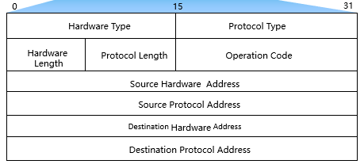
Link Layer Protocols
ARP Packet

Slide 39
Link Layer Protocols
ARP
The ARP packet is generated as part of the physical target address discovery process.
Initial discovery will contain partial information since the destination hardware address or MAC address is to be discovered.
The hardware type refers to Ethernet with the protocol type referring to IP, defining the technologies associated with the ARP discovery.
The hardware and protocol length identifies the address length for both the Ethernet MAC address and the IP address, and is defined in bytes.
The operation code specifies one of two states, where the ARP discovery is set as REQUEST for which reception of the ARP transmission by the destination will identify that a response should be generated.

Slide 40
Link Layer Protocols
ARP
The response will generate REPLY for which no further operation is necessary by the receiving host of this packet, and following which the ARP packet will be discarded.
The source hardware address refers to the MAC address of the sender on the physical segment to which ARP is generated.
The source protocol address refers to the IP address of the sender.

Slide 41
Link Layer Protocols
ARP
The destination hardware address specifies the physical (Ethernet) address to which data can be forwarded by the Ethernet protocol standards, however this information is not present in an ARP request, instead replaced by a value of 0.
The destination protocol address identifies the intended IP destination for which reachability over Ethernet is to be established.

Slide 42
Link Layer Protocols
ARP Cache (kash)
The ARP cache (pronounced as [kash]) is a table for association of host destination IP addresses and associated physical (MAC) addresses.
Any host that is engaged in communication with a local or remote destination will first need to learn of the destination MAC via which communication can be established.

Slide 43
Link Layer Protocols
ARP Cache (kash)
Learned addresses are used to populate the ARP cache table and remain active for a fixed period of time, during which the intended destination can be discovered without the need for addition ARP discovery processes.
Following a fixed period, the ARP cache table will remove ARP entries to maintain the ARP cache table’s integrity, since any change in the physical location of a destination host may result in the sending host inadvertently addressing data to a destination at which the destination host no longer resides.

Slide 44
Link Layer Protocols
ARP Cache (kash)
The ARP cache lookup is the first operation that an end system will perform before determining whether it is necessary to generate an ARP request.
For destinations beyond the boundaries of the hosts own network, an ARP cache lookup is performed to discover the physical destination address of the gateway, via which the intended destination network can be reached.

Slide 45
QUESTIONS!

